Slide 1

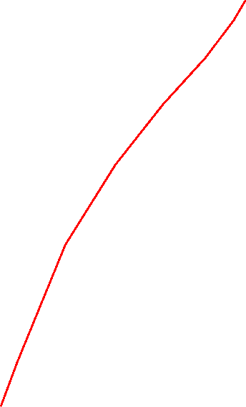
DEPARTMENT OF INFORMATION TECHNOLOGY
Project name : TRAFFIC MANAGEMENT SYSTEM
Team name : Proj_224783_Team_7
Team members : Roshini Shree R(113321205041)
Yamini G(113321205058)
Elsey Margreat Gladies A(113321205013)
Rosha S K(113321205040)

Slide 2
PROJECT
A Traffic Management System (TMS) is a comprehensive set of integrated technologies, strategies, and practices designed to monitor, control, and optimize the flow of traffic on road networks. Its primary goal is to enhance traffic safety, efficiency, and sustainability. Here's an overview of the key components and functions of a typical Traffic Management System:
Traffic Monitoring and Data Collection:
Sensors, cameras, and other monitoring devices are deployed across the road network to gather real-time data on traffic conditions, including vehicle counts, speeds, and congestion levels.
Data Processing and Analysis:
Advanced algorithms process the collected data to identify traffic patterns, forecast trends, and detect anomalies. This analysis helps in making informed decisions about traffic control strategies
Traffic Control Center:
A centralized control center serves as the nerve center of the system. It's staffed by traffic management personnel who oversee the operation, monitor data feeds, and make real-time adjustments to traffic signals and controls.

Slide 3
Components required
1 .Traffic Sensors
2. Traffic Lights
3.Raspberry pi
4. Communication Protocols(WIFI OR EHTERNET OR ZIGBEE)
5. Centralized Server or Cloud Service
6. Data Storage
7.User Interface
8. Actuators
9. Power Management(BATTERY)
10. Optional Components(LED DISPLAY,GPS,CAMERAS)

Slide 4
Python code
import time
def control_traffic():
while True:
print("\nGreen light for North-South traffic")
time.sleep(10) # Green light duration
print("\nYellow light for North-South traffic")
time.sleep(2) # Yellow light duration
print("\nRed light for North-South traffic")
# Simulate vehicle detection and decision making
time.sleep(1) # Time for vehicle to cross
print("\nGreen light for East-West traffic")
time.sleep(10) # Green light duration
print("\nYellow light for East-West traffic")
time.sleep(2) # Yellow light duration
print("\nRed light for East-West traffic")
if __name__ == "__main__":
control_traffic()

Slide 5
Code explanation
Creating a complete traffic management system is a complex task that involves various components such as sensors, databases, user interfaces, and possibly hardware integration. Below, I'll provide a basic Python code outline for a simple traffic light simulation. Keep in mind that this is a simplified example and doesn't cover all aspects of a real-world traffic management system.
Keep in mind that this is a basic simulation and does not interact with any physical hardware or real-world data. For a complete traffic management system, you would need to incorporate things like sensors, actuators, databases, user interfaces, and potentially even machine learning algorithms for more advanced traffic management.
If you are working on a larger project, consider breaking it down into smaller, manageable parts, and start by implementing each component one by one. Additionally, you may want to look into libraries like Flask or Django for building web interfaces, and consider using external libraries for interfacing with hardware components if necessary.

Slide 6
CONCLUSION
In conclusion, a well-implemented traffic management system is essential for enhancing road safety, reducing congestion, and improving overall transportation efficiency. Through the use of advanced technology, data analytics, and smart infrastructure, such systems have the potential to transform urban mobility and make our roads safer and more accessible for everyone. However, their success depends on continuous investment, maintenance, and adaptation to the evolving needs of our cities and transportation networks. With a commitment to innovation and collaboration between government authorities, technology providers, and the public, we can create a more sustainable and efficient future for urban transportation.

Slide 7
THANK YOU

